Slide 1

How to Create a CVE Record
CVE Team
Notes:
Voice Track: Hello and welcome to How to create a CVE Entry presentation, presented by the CVE team. Once you have assigned the CVE IDs, performed your coordination to get the vulnerability fixed, and published the vulnerability information, you are going to need to populate the CVE entry. In these slides, we will go over how to create a CVE entry.

Slide 2
What is a CVE Record
The CVE Program Root CNA (currently MITRE) maintains the CVE List, which is a list of CVE Records (formerly “CVE Entries)
A CVE Record contains:
  CVE ID
  Description
  References
Notes:
Voice Track: CVE entries are uploaded into the CVE master list. CVE Entries contain the CVE ID, a description, references, and other metadata.

Slide 3
Purpose of a CVE Record
Informs users which vulnerability the CVE ID is assigned to
Inform users when a new CVE Record is made public
Explain why the vulnerabilities in the CVE List are different
Justify the counting decisions that were made
Create a historical log CVE ID assignments
Notes:
Voice Track: CVE entries informs users which ID is associated with a vulnerability, informs users when there is a new vulnerability, how the vulnerability is different from the other vulnerabilities, confirms the counting decisions made and creates a historical log of CVE IDs assignments.

Slide 4
Minimum Requirements
Defined in the CNA Rules:
  CVE ID
  Product name
  Version (affected and/or fixed)
  Problem type (vulnerability type, root cause, and/or impact)
  Description
  Reference (one or more)
Accept the CVE Program’s Terms of Use
  https://cve.mitre.org/about/termsofuse.html
  Acceptance is required so that the CVE Secretariat can make the CVE List freely available to anyone who wants to use it
Notes:
Voice Track: When submitting a CVE entry, it must contain a CVE ID, product name, version information (whether affected or fixed), a problem type (either a vulnerability type, root cause, or impact), a prose description, and one or more references. Accepting the CVE program’s Terms of Use is required so MITRE, the Program Root CNA, can make the CVE list available to the public, allowing republishing of the information provided and downstream users of CVE can do the same.

Slide 5
Minimum Description Requirements
Include product, version and vulnerability type, root cause, or impact
  MUST provide enough product information for a reader to have a reasonable understanding of what products are affected
  Version information should be included, not a must
  MUST include Vulnerability type, root cause, or impact.
Product, Version and Vulnerability type, root cause, or impact need to be in both locations
Only information in the provided References can be included in the Description
  The CVE Program needs to be trusted not to leak the privileged information reporters share with it. Requiring that every detail be backed up by another source helps keep this trust
Only relevant information about the vulnerability should be included
Must be in English (when sent to the Program Root CNA)
Notes:
Voice Track: The description in the CVE entry has additional requirements. First, the product information in the description must provide enough information for a reader to have a reasonable understanding of what products are affected. If the affected products are not explicitly listed in the description, then the CNA MUST provide a reference that points to the known affected products. Second, Version information should be included. Lastly, either a vulnerability type, root cause, or impact MUST be included in the description.
Product, Version and Vulnerability type, root cause, or impact need to be in both locations, these because the separate fields are not currently included in the CVE List used by downstream users
Many of our downstream users only look at the description and will be confused if the product information is not included, for example.
All details in the description must be supported by information in the references. The CVE Program is trusted with embargoed information.
All information in the description should be relevant to the vulnerability and the description must be in English. Using the JSON format, you can provide descriptions in multiple languages, but at least one of them must be in English.

Slide 6
Additional Information Often Included
Distinguishing Details
  Component names
  Attack vectors
  Root cause
Threat Details
  Attacker
  Impact
Remediation Details*
Conditions
Proof of Concepts (PoC)*
Credits*
* Not traditionally included (by Program Root CNA) in CVE Record Descriptions
Notes:
Voice Track: You can provide more details than those required. For example, you may want to include whether the attacker needs to be authenticated or if the vulnerability can be exploited remotely.

Slide 7
Goldilocks Records
Too few details result in:
  Users not being able to tell which vulnerability the ID is assigned to
  Duplicate assignments
Too many details result in:
  Makes the Description more difficult to read
  Increases the chance of errors
The perfect CVE Record gives just enough information to identify and distinguish the vulnerability from others, and nothing else
Notes:
Voice Track: Writing a good description is as much an art as it is a science. Every CNA balances providing enough information for users to defend themselves without disclosing too much information.

Slide 8
Why Include More than the Minimum?
Records with the minimum details do not always meet the goals of a CVE Record:
  Tell CVE users which vulnerability the CVE ID is assigned to
  Explain why the vulnerabilities in the CVE List are different
  Inform users when a new CVE Record is made public
  Justify the counting decisions that were made
Including more information will help downstream users
Notes:
Voice Track: We ask that you provide more than just the minimum information because it is often not enough to distinguish between vulnerabilities. You can imagine how many buffer overflows there are in a particular version of Windows.

Slide 9
Example 1: Minimum Information Comparison
CVE-YYYY-0001
  Buffer overflow in PRODUCT_X before 1.2.3.
CVE-YYYY-0002
  Buffer overflow in PRODUCT_X before 1.2.3.
These two records are identical. As far as the outside world is concerned, they might as well be the same record
Notes:
Voice Track: And we have an example of this. Here only the minimum information was provided so the descriptions look the same. To help distinguish between the two entries, we added that they are different at the end of description.

Slide 10
Example 2: Distinguishable Through the Component
CVE-YYYY-0003
  Buffer overflow in the file upload functionality of Product_X before 1.2.3
CVE-YYYY-0004
  Buffer overflow in the networking functionality of Product_X before 1.2.3
You can now tell the two records apart, but it would still be difficult to tell if the vulnerability you just discovered is the same vulnerability as CVE-YYYY-0003 or CVE-YYYY-0004
Notes:
Voice Track: Here is another example, where additional information was provided, and the two vulnerabilities can now be distinguished. However, if I was a researcher and found a vulnerability, this is probably not enough information to determine whether the vulnerability has been rediscovered.

Slide 11
Example 3: Descriptive Root Cause
CVE-YYYY-0005
  Product_X before 1.2.3 does not properly check the length of the file name before storing it in a buffer, which causes a buffer overflow.
CVE-YYYY-0006
  Product_X before 1.2.3 does not validate the packetSIZE field when using it to allocate the size of a buffer, which cause a buffer overflow.
The more specific root cause descriptions provide enough details to tell the two vulnerabilities apart and maybe enough to identify if the CVE ID applies to a vulnerability
Notes:
Voice Track: Providing some additional information, like the root causes in this case, may allow researchers to do the mapping and reduce duplicate requests.
.

Slide 12
Example 4: Too Specific
CVE-YYYY-0007
  Description
    Buffer overflow in file_upload.c:523 in PRODUCT_X before 1.2.3
  The description contains a line number where the fault happens. However, it is possible that the vulnerability could be cause by a chain of faults in multiple locations of the code
CVE-YYYY-0008
  Description
    Buffer overflow in PRODUCT_X fork of PRODUCT_A before 1.2.3.
  If you are going to claim that only the PRODCUCT_X fork is affected, the make sure that is true.
Notes:
Voice Track: However, you can also get too specific. In the top example, the description says that the vulnerability originates on line 523 of file_upload.c. However, the vulnerability is really a chain of bugs in multiple locations. Adding the line number could give the impression that CVE IDs should be assigned at a per bug level.
The description in the bottom example, says the vulnerability is in the Product_X fork. Make sure that the main branch if not affected before claiming that only the fork is affected.
So be careful with what you put in a description.

Slide 13
What Should You Do
There is no perfect answer
  If there were, we would have included in the CNA Rules
If you already have a process for writing Descriptions and publishing advisories, we do not expect you change them
  Unless they do not contain the required information
  Unfortunately, due to the way most CNAs structure their advisories, they have to write new Descriptions for the CVE Records
The information in the record is always limited by the details that are made public
Notes:
Voice Track: So, what should you do? Again, there is not perfect answer. If you already have a process for writing descriptions, and they meet the minimum requirements for a description, then we do not expect you change them. Unfortunately, due to the way most CNAs structure their advisories, they have to make modifications before they can submit the description to the Program Root CNA.

Slide 14
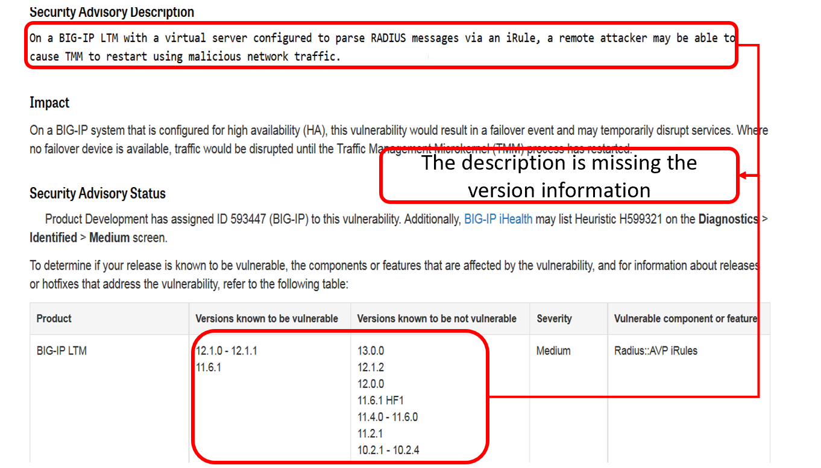
Example: Formatting Requires Description Change for CVE Record Submission
CVE-YYYY-0100
A
Notes:
Voice Track: Here we have an example from COMPANY A where the description for their advisory is almost exactly what is required, but the version information is in a separate table. When the CVE entry is submitted, the version information should be added to the description.

Slide 15
Use the Program Root CNA style template
Use the Program Root CNA’s style template
  [VULNTYPE] in [COMPONENT] in [VENDOR][PRODUCT] [VERSION] allows [ATTACKER] to [IMPACT] via [VECTOR].
  [COMPONENT] in [VENDOR] [PRODUCT] [VERSION] [ROOT CAUSE], which allows [ATTACKER] to [IMPACT] via [VECTOR].
Need help with writing your description, go to the CVE GitHub website
  http://cveproject.github.io/docs/content/key-details-phrasing.pdf
Notes:
Voice Track: If you don’t have your own description style, you can use ours. It is a simple fill in the blank sentence. If you need help with writing your description, go to the CVE GitHub website, key-details-phrasing pdf document.

Slide 16
What Shouldn’t Be in a CVE Record
Advertising
Code excerpts/diffs
Exploits/Proof of Concepts
Inappropriate language
Notes:
Voice Track: There are certain things that should not be in a CVE entry. No advertising or inappropriate language. No Code excerpts, diffs, exploits, or proofs of concepts. All of the CVE entries go through transforms and none of the formatting will be preserved.

Slide 17
Record Creation Tips
Notes:
Voice Track: Here are some additional tips for creating a CVE entry.

Slide 18
Avoid Using Commit IDs as Versions
Sometimes it is unavoidable because the product has no other versioning scheme
However, commit IDs present a number of problems:
  There isn’t a good way to tell if your version of the product has the commit
  It’s hard to tell which version contains the commit
  Commit IDs change when moved to a new system, e.g., git to SVN
CVE-YYYY-0009
  A use-after-free vulnerability was observed in Rp_toString function of PRODUCT Software, Inc. MuJS before 5c337af4b3df80cf967e4f9f6a21522de84b392a. A successful exploitation of this issue can lead to code execution or denial of service condition.
Notes:
Voice Track: Avoid using commit IDs as versions. Downstream users will rarely know if the version they are using has that commit. There have been instances where the commit ID have changed. However, sometimes the commit ID is all you have to use.

Slide 19
Avoid Saying All Versions Are Affected
Avoid making statements like “all version” or “version X and later”
  People (including security tool vendors) will take you at your word, and won’t always get the update when the vulnerability is fixed
CVE-YYYY-0010
  All versions of the XYZ Windows GPU Display Driver contain a vulnerability in the kernel mode layer (nvlddmkm.sys) handler for DxgDdiEscape where user provided input can trigger an access to a pointer that has not been initialized which may lead to denial of service or potential escalation of privileges.
  Fixed on May 9, 2017
  https://nvidia.custhelp.com/app/answers/detail/a_id/4462
Notes:
Voice Track: Avoid saying “all versions” or “versions X and later” are affected. People will take you at your word (including vulnerability scanners) and they won’t always look for an update.

Slide 20
Be Clear Which Products Are Affected
If an upstream, bundled product is affected, clearly indicate that it contains the vulnerability
CVE-YYYY-0012
  An integer overflow in FFmpeg in PRODUCT B prior to 57.0.2987.98 for Mac, Windows, and Linux and 57.0.2987.108 for Android allowed a remote attacker to perform an out of bounds memory write via a crafted video file, related to ChunkDemuxer.
  Readers may think that this vulnerability only affects PRODUCT B, but it really affects any product using FFmpeg
Program Root CNA uses the following phrasing in these cases
  [UPSTREAM PRODUCT] [AFFECTED VERSION], as used in [DOWNSTREAM PRODUCT]
Notes:
Voice Track: If you assign a CVE ID to a third-party product, please make it clear that it is the origin of the vulnerability. In the example, the description reads as if only PRODUCT B is affected, when in reality, Ffmpeg and any other product using Ffmpeg are affected.

Slide 21
Conclusion
| 21 |
Notes:
Voice Track: This concluded this presentation.

