Slide 1

CNA Processes
CVE Team
Notes:
Voice Track: Hello and welcome to CNA Processes presentation, presented by the CVE team.

Slide 2
Overview
| 2 |
Getting a CVE ID Block
Assigning CVE IDs
Submitting CVE Entries
Updating CVE Entries
Escalating Issues
Rejecting CVE IDs
Disputing CVE IDs
CVE ID Expiration
Notes:
Voice Track: This presentation includes an overview of how to get a block of CVE IDs, how to assign vulnerabilities to CVE IDs, how to submit CVE entries, updating CVE entries when necessary, how to escalate issues where there is a dispute, how to reject CVE ID’s when needed, how to dispute a CVE ID and the process for handling expiring CVE ID’s.

Slide 3
CVE ID States Terms
| 3 |
Allocated: When CVE IDs are first given to a CNA for later assignment to a vulnerability, they are in the allocated stated.
Assigned: If a CVE ID has been associated with a vulnerability by a CNA, then the CVE ID is in the assigned state.
Public: If the CVE ID is being used publicly to discuss a vulnerability, then it is in the public state. See Section 8.3 Reference Requirements for the requirements for the CVE Program to consider a CVE ID public.
Rejected: If the CVE ID should no longer be used, then it is in the rejected state
Notes:
Voice Track: Listed here are a few terms to you should be familiar with.

Slide 4
Getting a CVE ID Block
Notes:
Voice Track: How to obtain a block of CVE IDs

Slide 5
Determine process for getting a CVE ID block
The Root CNA defines how sub-CNA’s can obtain CVE IDs
The Root CNA may choose to have CNA’s:
    Go directly to the Root
    Go directly to the Secretariat
Notes:
Voice track: The Root CNA defines how sub-CNA’s can obtain CVE IDs. The Root CNA may choose to have CNA’s:
go directly to the Root or go directly to the Secretariat. The next few slides provides the process for both.

Slide 6
1) Root CNA request a block of CVE IDs
10 YYYY CVE IDs please!
Root CNA
Secretariat
CVE-YYYY-0001
CVE-YYYY-0002
CVE-YYYY-0003
CVE-YYYY-0004
CVE-YYYY-0005
CVE-YYYY-0006
CVE-YYYY-0007
CVE-YYYY-0008
CVE-YYYY-0009
CVE-YYYY-0010
Notes:
Voice Track: THE Root The Root CNA asks the Secretariat for a block of CVE IDs. The Secretariat sends the CVE IDs to the Root CNA

Slide 7
1) Root CNA Provides the IDs to the Sub-CNAs
3 YYYY CVE IDs please!
Sub-CNA
CVE-YYYY-0001
CVE-YYYY-0002
CVE-YYYY-0003
Sub-CNA
Root CNA
CVE-YYYY-0004
CVE-YYYY-0005
CVE-YYYY-0006
Sub-CNA
CVE-YYYY-0007
CVE-YYYY-0008
CVE-YYYY-0009
Notes:
Voice Track: The Sub-CNAs ask the Root CNA for a block of CVE IDs. The Root CNA provides a block of CVE IDs to each Sub-CNA.

Slide 8
2) Secretariat: CNA goes directly to the Secretariat
10 YYYY CVE IDs please!
CNA
Secretariat
CVE-YYYY-0001
CVE-YYYY-0002
CVE-YYYY-0003
CVE-YYYY-0004
CVE-YYYY-0005
CVE-YYYY-0006
CVE-YYYY-0007
CVE-YYYY-0008
CVE-YYYY-0009
CVE-YYYY-0010
Notes:
Voice Track: The CNA asks the Secretariat for a block of CVE IDs. The Secretariat sends the CVE IDs to the CNA.

Slide 9
What to Consider When Making a Request for a CVE ID
How many CVE IDs to request
  Negotiated with parent CNA
  Plenty of IDs to last the entire year
When to request for more CVE IDs
  Inventory is low
  Calendar year end (IDs for next year)
  New CNA
What year to ask for CVE IDs
  Current year likely
  IDs for the next year are requested at calendar year end (last quarter)
Notes:
Voice Track: How many CVE IDs you request should be negotiated with your parent CNA. In most cases, CNAs should have enough IDs to last the entire year. You should request more CVE IDs when you are running low, at the end of year to obtain IDs for the next year and if you are a new CNA. The year to ask for CVE IDs most of the time will be the current year, however, CVE ID’s for the next year are normally requested at calendar year end.

Slide 10
Contact Details Vary by CNA
Each Root CNA will have their own method of receiving and processing block requests
Your Parent CNA should provide you with instructions on how to request blocks of CVE IDs
For example, if your parent CNA is the Program Root CNA (currently MITRE), there is web form for these requests
  https://cveform.mitre.org/
Notes:
Voice Track: Each Root CNA will have their own method of receiving and processing block requests. Your parent CNA should provide you with instructions on how to requests blocks of CVE IDs. For example, if your parent CNA is the Program Root CNA (currently MITRE), there is web form for CVE ID block requests, go to https://cveform.mitre.org/

Slide 11
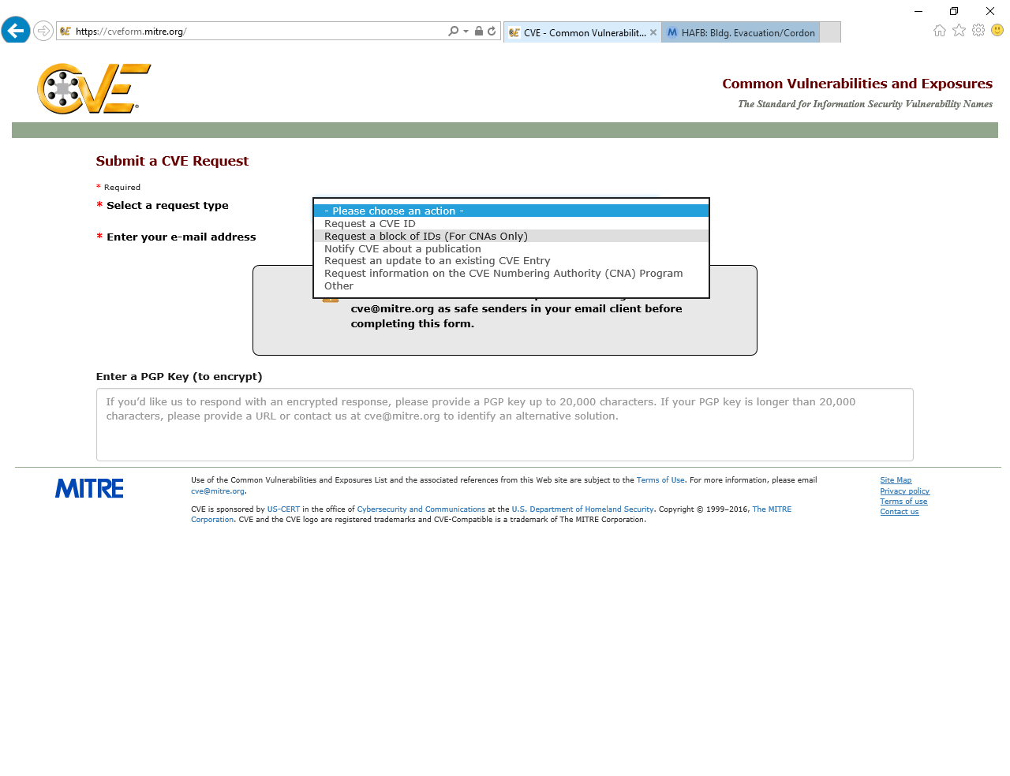
MITRE Form: Select Block ID Request
Notes:
Voice Track: In the “Select a request type” field, choose Request a block of IDs (For CNAs Only).

Slide 12
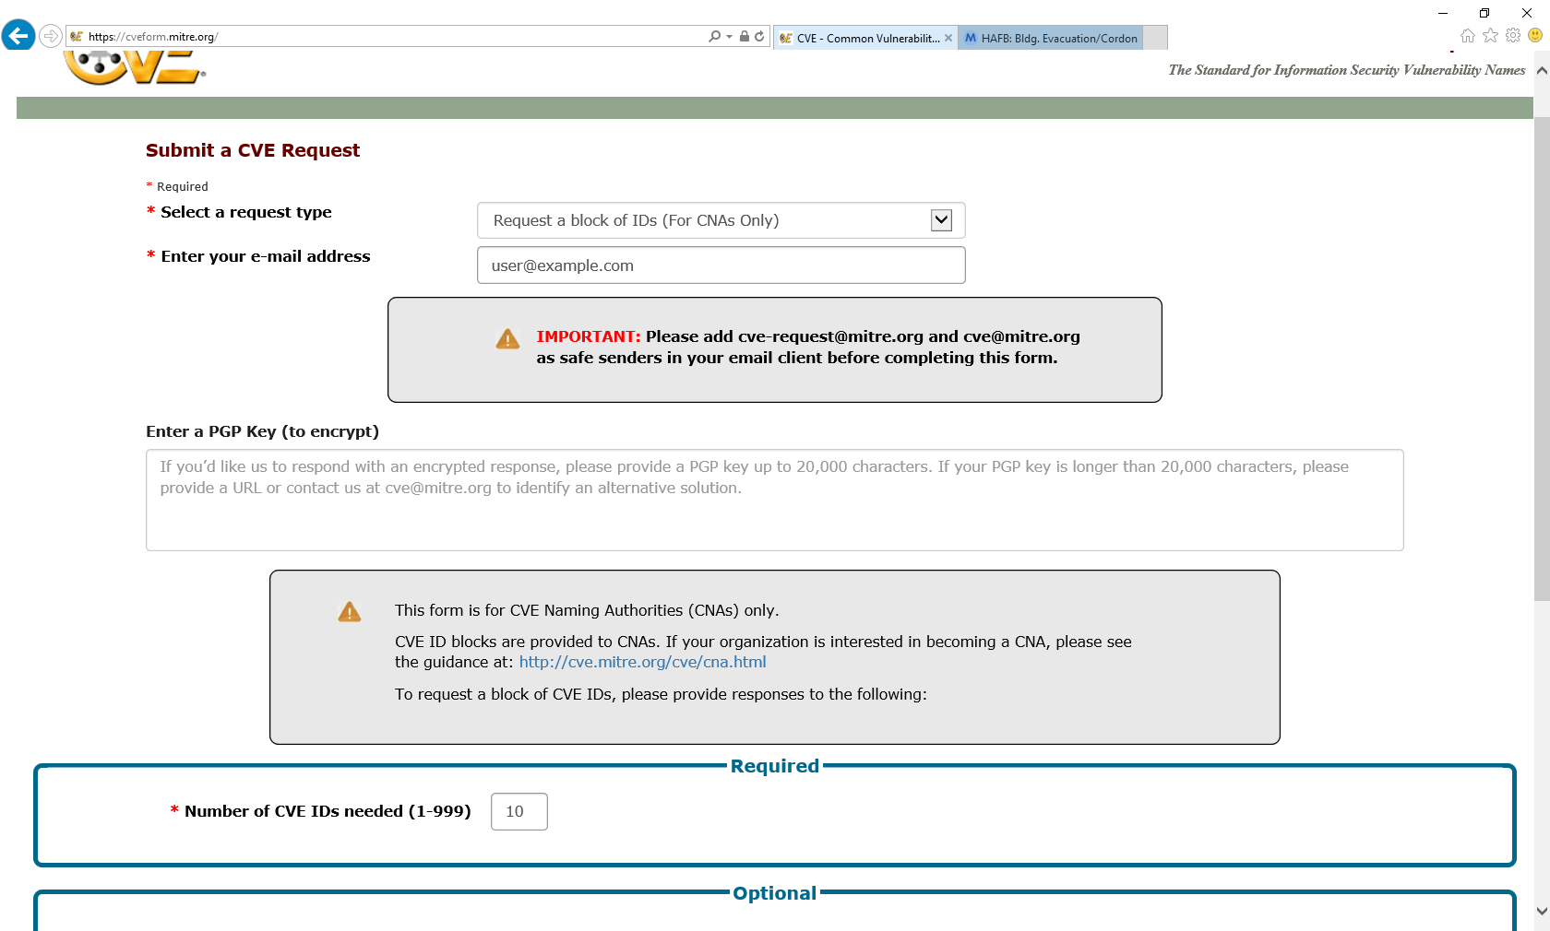
MITRE Form: Fill in Contact Details
Notes:
Voice Track: Next, select from the request type, “request a block of CVE Id’s and enter your email address. If you would like us to respond with an encrypted response, enter a PGP Key.

Slide 13
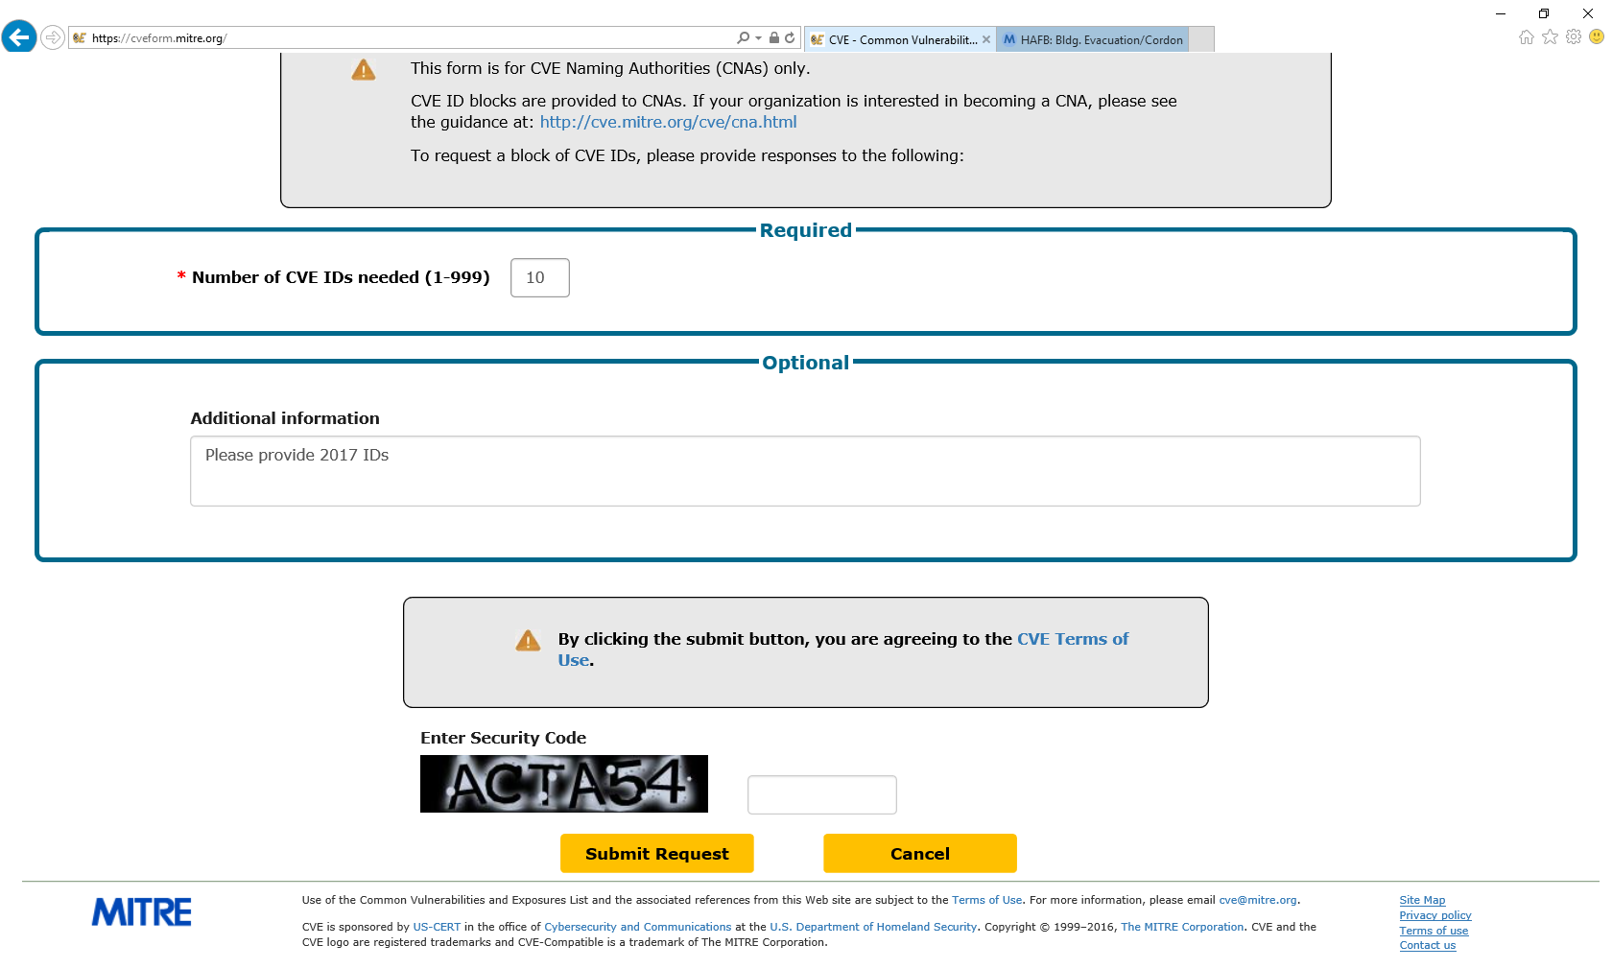
MITRE Form: Fill in Request Details
Notes:
Voice Track: Enter the number of CVE IDs you are requesting and in “number of CVE IDs needed field”. In the additional information field, provide the year of the CVE IDs you are requesting. Lastly, enter the security code and press “submit request”

Slide 14
CVE ID Assignment
Notes:
Voice Track: Up next, how to assign CVE ID’s.

Slide 15
Reporter Sends Vulnerability Information
I would like to report some vulnerabilities to you…
Reporter
CNA
Notes:
Voice Track: A reporter sends vulnerability information to you, “I would like to report some vulnerabilities to you…”

Slide 16
CNA Acknowledges Receipt
Thank you for the report. We will look into it and get back to you soon.”
Reporter
CNA
Notes:
Voice Track: As the CNA, you respond with something like “Thank you for the report. We will look into it and get back to you soon.”

Slide 17
CNA Counts the Number of Vulnerabilities
Independently
Fixable Issue
Determine if
a Vulnerability
Determine is
Results from Shared
Code, Library, or
Standard
Issue 1
I would like to report some vulnerabilities to you…
Vuln. 1
Issue 2
Vuln. 1
Vuln. 2
Issue 3
Vuln. 2
Issue 4
Vuln. 3
Vuln. 5
Vuln. 6
Issue 5
Vuln. 4
Notes:
Voice Track: The next step is to count the number of vulnerabilities. To do that, the first step is to take the report and break it down into independently fixable issues and then determine if those issues are vulnerabilities, if they are, then you determine what set of products those vulnerabilities effect.

Slide 18
CNA Decides Whether to Assign an ID
In Scope
Make Public
Customer
Controlled
Publicly
Available
Software
Avoid
Duplicates
Vuln. 1
Vuln. 1
Vuln. 1
Vuln. 1
Vuln. 2
Vuln. 2
Vuln. 2
Vuln. 2
Vuln. 2
Vuln. 2
Vuln. 5
Vuln. 5
Vuln. 6
Vuln. 6
Vuln. 6
Vuln. 6
Vuln. 6
Vuln. 6
Notes:
Voice Track: Once you know the effected products, then determine if the vulnerabilities are within your scope. If the vulnerabilities are within your scope, next you determine if you are going to make the vulnerability public. Next, determine if the product is customer controlled and if the software is publicly available. Lastly, determine is there is a CVE ID already assigned to the vulnerability.

Slide 19
CNA Records Assignments
CVE ID Assignment Records
Vuln. A | CVE-YYYY-1024
Vuln. B | CVE-YYYY-1025
Vuln. 2 | CVE-YYYY-1026
Vuln. 6 | CVE-YYYY-1027
CVE-YYYY-1024
CVE-YYYY-1025
CVE-YYYY-1026
CVE-YYYY-1027
CVE-YYYY-1028
CVE-YYYY-1029
CVE-YYYY-1030
CVE-YYYY-1031
CVE-YYYY-1032
CVE-YYYY-1033
Vuln. 2
Vuln. 6
Notes:
Voice Track: Next, you assign CVE ID’s to each vulnerability. Make sure to record the assignment in a centralized location to prevent accidentally assigning the same CVE ID to different vulnerabilities

Slide 20
CNA Informs Reporter of Assignments
…
Vuln. 2 is assigned
CVE-YYYY-1026 and
Vuln. 6 is assigned
CVE-YYYY-1027
…
Reporter
CNA
Notes:
Voice Track: The CNA informs the reporter of CVE ID assignments.

Slide 21
Submitting CVE Entries
Notes:
Voice track: Once you have assigned the CVE IDs, performed your coordination to get the vulnerability fixed, and published the vulnerability information, you are going to need to submit the CVE entry.

Slide 22
CVE Entry States Terms
| 22 |
Reserved: When a CVE ID has been allocated to a CNA, it is immediately added to the CVE List in the reserved state. The reserved entry is a placeholder until the information about the vulnerability is made public.
Populated: When the information for the vulnerability is filled in the CVE List, the CVE Entry is considered populated. Populated can also be used as a verb to describe the process of filling the vulnerability details into the CVE Entry.
Rejected: When the CVE ID and associated CVE Entry should no longer be used, the CVE Entry is in the rejected state. Rejected CVE Entries remain in the CVE List so that users can know when it is invalid.
Reserved but Public (RBP): A term used to describe when the CVE ID is in the public state but the associated CVE Entry is in the reserved state. This happens when a CNA has published its advisory for the vulnerability but has not populated the CVE Entry.
Notes:
Voice Track: Listed here are a few terms to you should be familiar with.

Slide 23
Determine process for submitting CVE details
The Root CNA determines how sub-CNAs submit CVE details
The Root CNA may choose to have CNA’s:
    Submit directly to the Root
    Submit directly to the Secretariat
Notes:
Voice track: The Root CNA determines how sub-CNAs submit CVE details. The Root CNA may choose to have CNA’s:
Submit directly to the Root or submit directly to the Secretariat. The next few slides provides an overview for submitting directly to the Root CNA.

Slide 24
CNA Publishes Advisory with CVE Details
www.example.com/security-advisory-1
Fixed Vuln. 2 (CVE-YYYY-1026)
Fixed Vuln. 6 (CVE-YYYY-1027)
CNA
Publish advisory
Notes:
Voice Track: CNA publishes an advisory with CVE Details

Slide 25
CNA Formats Details as Required
[CVEID]: CVE-YYYY-1026
[PRODUCT]: MY-PRODUCT
[VERSION]: 1.2.3
[PROBLEMTYPE]: Buffer overflow
[REFERENCES]: www.example.com/security-advisory-1
[DESCRIPTION ]: Buffer overflow in MY-PRODUCT 1.2.3
[CVEID]: CVE-YYYY-1027
….
CNA
Notes:
Voice Track: CNA formats the CVE details as required. The vulnerability must be made public before the CVE entry can be populated.

Slide 26
CNA Sends Formatted CVE Details to Root CNA
[CVEID]: CVE-YYYY-1026
…
[CVEID]: CVE-YYYY-1027
…
CNA
Root CNA
Notes:
Voice Track: Before submitting the CVE details, the CNA must put the information into one of the approved formats. CNA sends the formatted details to Root CNA.

Slide 27
Root CNA Sends the CVE Details to the Secretariat
[CVEID]: CVE-YYYY-1026
…
[CVEID]: CVE-YYYY-1027
…
Root CNA
Secretariat
Notes:
Voice Track: Root CNA Sends the CVE details to the Secretariat.

Slide 28
Secretariat Updates the Master CVE List
Submission
CVE List
[CVEID]: CVE-YYYY-1026
[PRODUCT]: MY-PRODUCT
[VERSION]: 1.2.3
[PROBLEMTYPE]: Buffer overflow
[REFERENCES]: www.example.com/security-advisory-1
[DESCRIPTION ]: Buffer overflow in MY-PRODUCT 1.2.3
[CVEID]: CVE-YYYY-1027
….
Name: CVE-YYYY-1026
Status: Candidate
URL: http://cve.mitre.org/cgi-bin/cvename.cgi?name=CVE-YYYY-1026
Phase: Assigned (YYYYMMDD)
Category:
** RESERVED **
This candidate has been reserved by an organization or individual that will use it when announcing a new security problem. When the candidate has been publicized, the details for this candidate will be provided.
Notes:
Voice Track: Secretariat Updates the Master CVE List

Slide 29
Secretariat Publishes Updated CVE List
Name: CVE-YYYY-1026
Status: Candidate
URL: http://cve.mitre.org/cgi-bin/cvename.cgi?name=CVE-YYYY-1026
Phase: Assigned (YYYYMMDD)
Category:
Reference: CONFIRM: www.example.com/security-advisory-1
Buffer overflow in MY-PRODUCT 1.2.3
Current Votes:
None (candidate not yet proposed)
=================================
Name: CVE-2016-6260
…
Notes:
Voice Track: Secretariat publishes the updated CVE List.

Slide 30

Reserved by Public (RBP) Policy (MITRE’s Policy)
What happens if a CNA doesn’t populate an entry after they publish the CVE ID in their advisory?
  People complain (often to MITRE)
MITRE keeps track of requests to populate CVE entries
MITRE also monitors several sources for vulnerabilities
If the percentage of reserved CVE ID’s assigned by a CNA is greater than the total number of public CVE ID’s for the CNA in the last 12 months, then the CNA will not longer receive new CVE IDs until the percentage is below 5%.
Notes:
Voice Track: The RBP policy was created to ensure that CNAs populate their CVE ID’s timely. If the CVE IDs are not populated soon after the advisory is published, the user community will complain to MITRE. MITRE tracks request to populate as well as monitors various sources for vulnerabilities that are made public. The RBP policy states that the total RBP for a given CNA must be below 5%, this is calculated by taking the total RBPs CVE IDs and divided by the public CVE ID’s with the last 12 months. If the percentage of reserved CVE ID’s assigned by a CNA is greater than the total number of public CVE ID’s for the CNA in the last 12 months, then the CNA will not longer receive new CVE IDs until the percentage is below 5%.

Slide 31
Update CVE Entries
Notes:
Voice Track: How to update CVE entries.

Slide 32
CNA Is Asked to Update a CVE Entry
Please update CVE-YYYY-NNNN
….
Reporter
CNA
Notes:
Voice Track: CNA is asked by a reporter to update a CVE Entry

Slide 33
Determine Responsible CNA
Reporter/CNA
https://cve.mitre.org/cve/
CVE-YYYY-NNNN
Vulnerability in Product A allows attacker to do something bad.
https://cve.mitre.org/
CNA | Scope | Contact
CNA 1 | Scope 1 | Email 1
CNA 2 | Scope 2 | Form 1
CNA 3 | Product A… | Email 2
CNA 4 | Scope 4 | Email 3
CNA 5 | Scope 5 | Form 2
Notes:
Voice Track: Next, the CNA determines who the responsible CNA is. To determine who the responsible CNA is, go to cve.mitre.org to review the CNA scopes. If the change is within another CNA scope, please forward the request to the responsible CNA.

Slide 34
Responsible CNA Is Asked to Make the Change
Please update CVE-YYYY-NNNN
….
Reporter/CNA
Responsible CNA
Notes:
Voice Track: Next, the responsible CNA is asked to make the change

Slide 35
Responsible CNA Decides Whether to Change the Entry
Should the entry be updated?
Please update
CVE-YYYY-NNNN
…
Responsible CNA
Root CNA
Yes
Unfortunately, we do not believe
…
No
Reporter
Notes:
Voice Track: The responsible CNA decides whether to change the entry.

Slide 36
Updating CVE Entries with Counting Issues
Notes:
Voice Track: Sometimes you can make mistake when assigning CVE IDs, so how do you manage it?

Slide 37
Updating CVE Entries with Counting Issues
The processes for updating entries with counting issues are in Appendix C of the CNA Rules v3.0
  Rejecting CVE Entries
  Merging CVE Entries
  Splitting CVE Entries
  Disputing CVE Entries
Notes:
Voice Track: The processes for updating entries with counting issues are in the CNA Rules. CVE counting issues include;
Rejecting CVE entries, is when you assign a CVE ID that shouldn’t have been assigned
Merging CVE entries is when you assign the same vulnerability to multiple CVE ID’s
Splitting CVE entries is when you assign single CVE ID to multiple vulnerabilities
Disputing CVE entries is when there is a disagree if it’s even a vulnerability

Slide 38
Rejecting a CVE ID Outright
Reasons
  The issue is not a vulnerability
  You decide not to make the vulnerability public
  The product isn’t customer controlled
  The product isn’t generally available
Notes:
Voice Track: CVE IDs get rejected when an issue is not a vulnerability, or the issue should have not received a CVE ID.

Slide 39
Outright Rejection Process
Rejection Process:
  Update the Description saying that the CVE ID has been rejected
  Remove the References
Both populated and unpopulated entries can be rejected
Merging entries can also result in rejected CVE Entries
Notes:
Voice Track: The first step in the rejection process is to update the Description saying that the CVE ID has been rejected and then second, remove all references in the CVE entry. Both populated and unpopulated entries can be rejected, and merging entries can also result in rejected CVE Entries.

Slide 40
Rejection Description Template
** REJECT **
DO NOT USE THIS CANDIDATE NUMBER.
ConsultIDs:
Reason:
Notes:
Notes:
Voice Track: Here is the template for rejecting CVE entries.

Slide 41
Why Not Remove the Entry from the CVE List
CVE IDs remain on the CVE List to reduce confusion
  CVE IDs are used by many sources
  Not all sources change the CVE ID they use
  Having an entry explaining why the ID should not be used reduces confusion
Notes:
Voice Track: The CVE Entry is not removed from the CVE list because CVE IDs are used by many sources, not all sources change the CVE ID they use and having an entry explaining why the ID should not be used reduces confusion.

Slide 42
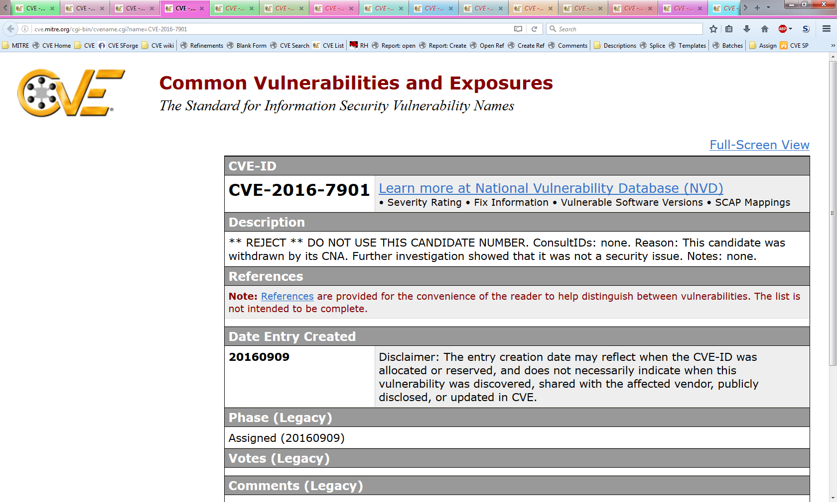
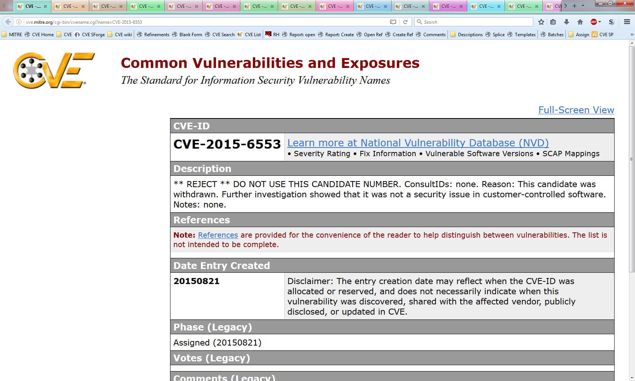
Examples of CVE IDs that Have Been Rejected
Notes:
Voice Track: Here is an example of CVE IDs that have been rejected

Slide 43
Merging CVE Entries
Not independently fixable
Result of shared codebase, library, protocol, etc.
Duplicate assignment
A typo in an advisory causes a duplicate assignment
Notes:
Voice Track: Merging of CVE ID’s occur when vulnerabilities' have received several CVE IDs.

Slide 44
Process for Merging CVE Entries
Determine which CVE ID to associate with the issue
Merge the information from the other CVE IDs into chosen CVE ID
Update the CVE IDs that were not chosen with a REJECT Description that points to the chosen CVE ID as the correct one to use
Notes:
Voice Track: The process for merging CVE entries, it to first determine which CVE ID to associate with the issue, then Merge the information from the other CVE IDs into chosen CVE ID and lastly, update the CVE IDs that were not chosen with a REJECT Description that points to the chosen CVE ID as the correct one to use.

Slide 45
Conditions for Deciding which CVE ID to Keep
Most referenced identifier
Most authoritative source
  Roughly prioritized as: vendor, coordinator, researcher
Longest public
Smallest numeric portion
Notes:
Voice Track: The conditions for deciding which CVE ID to keep is the Most referenced identifier, the most authoritative source, the ID that’s been public the longest and the smallest numeric portion.

Slide 46
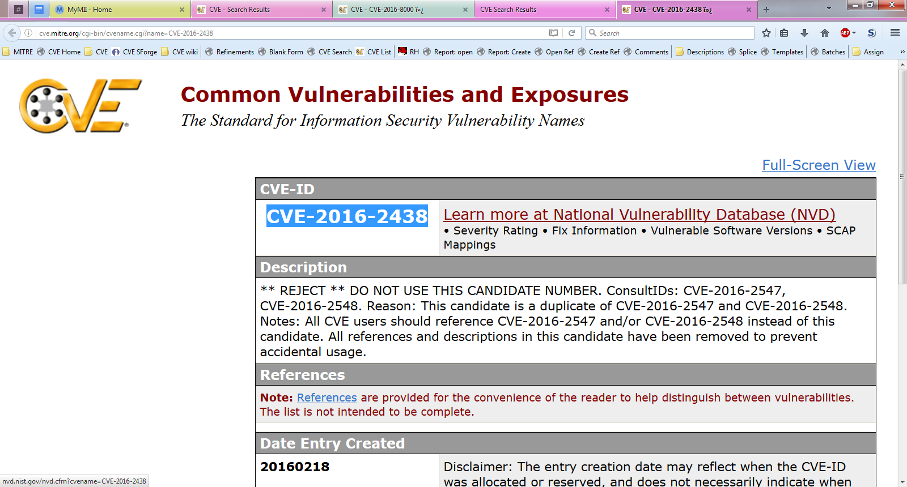
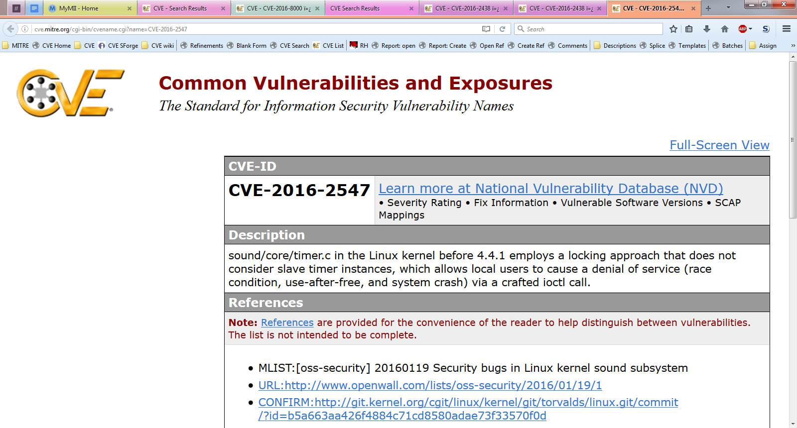
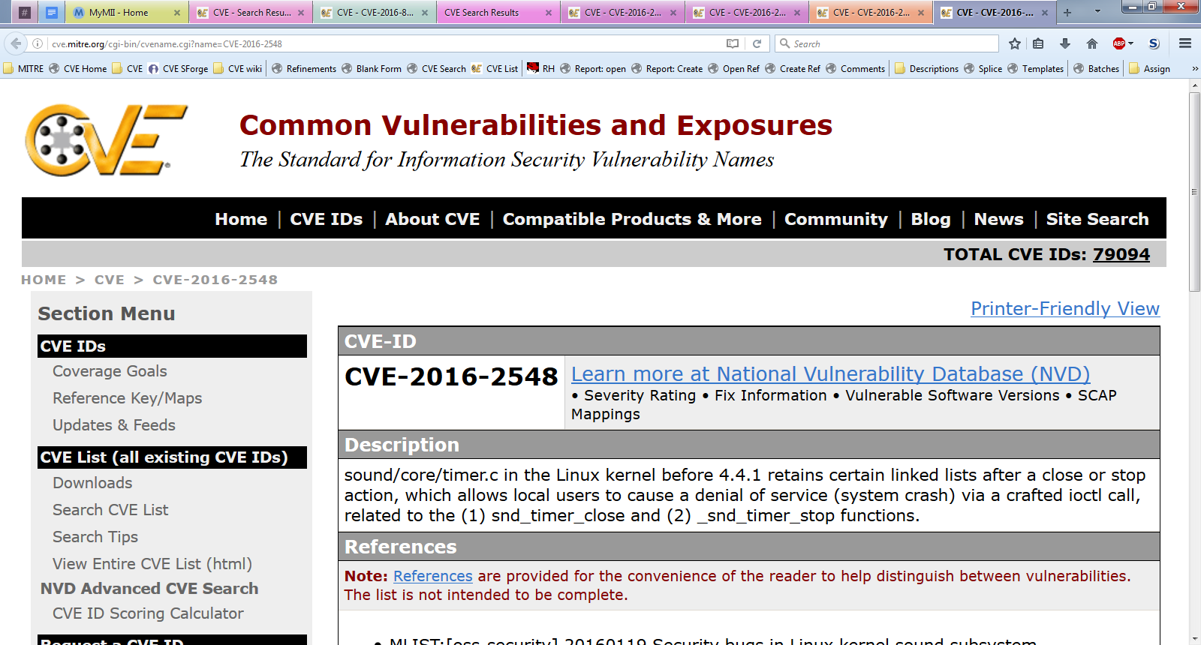
Example of a Merged CVE ID
Notes:
Voice Track: Here is an example of a merged CVE ID, note that a merge and a split happened.

Slide 47
Splitting CVE Entries
Contains interpedently fixable bugs
Does not share a codebase
Determined to be implementation specific
Notes:
Voice track: Splitting occurs with a single CVE ID is assigned for multiple vulnerabilities.

Slide 48
Splitting CVE IDs
Process for splitting
  Determine which vulnerability should be associated with the original CVE ID
  Assign CVE IDs to the additional vulnerabilities
  Include a NOTE pointing to the original CVE ID in the descriptions of the CVE Entries for the new CVE IDs
  Update Description of the CVE Entry for the original CVE ID with a NOTE saying that the entry has been split and point to the additional CVE IDs
Conditions for determining which vulnerability gets the original ID
  Most commonly associated vulnerability
  Most severe risk
  Broadest range of affected versions
  Described first in initial publication
Notes:
Voice Track: The process for splitting CVE IDs is to first Determine which vulnerability should be associated with the original CVE ID, Assign CVE IDs to the additional vulnerabilities, Include a NOTE pointing to the original CVE ID in the descriptions of the CVE Entries for the new CVE IDs and Update Description of the CVE Entry for the original CVE ID with a NOTE saying that the entry has been split and point to the additional CVE IDs. The conditions for determining which vulnerability gets the original ID are; the Most commonly associated vulnerability, the most severe risk, the broadest range of affected versions and the CVE ID that’s described first in initial publication.

Slide 49
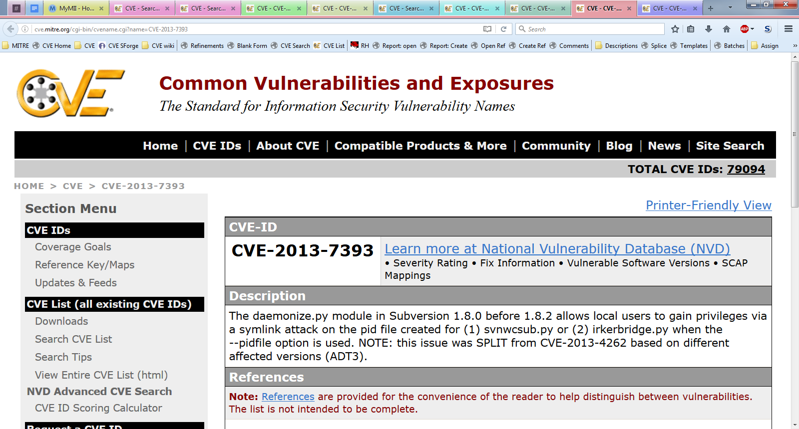
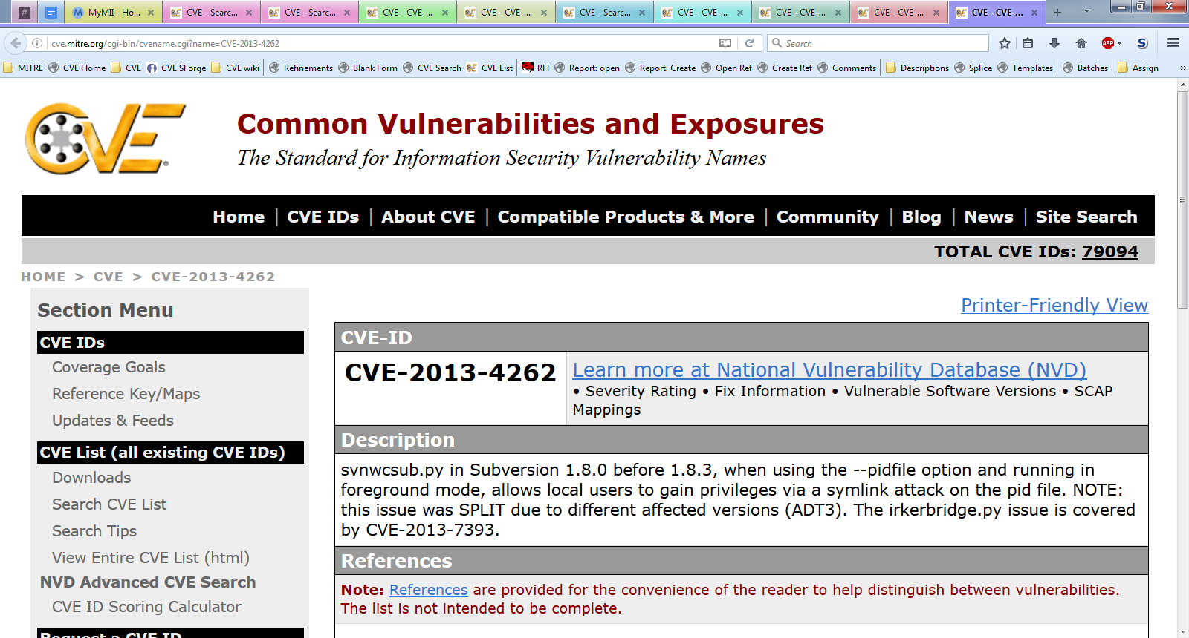
Split CVE ID Example
Notes:
Voice Track: Here is an example of split CVE IDs.

Slide 50
Disputed CVE Entries
Use a dispute when:
  The CVE ID was assigned correctly using the CNA Rules, but
  An authoritative source questions the validity of the vulnerability
Process creating a dispute
  Add “** DISPUTE **” to the beginning of the Description
  Add a NOTE to the end of the Description explaining why the vulnerability is disputed
Notes:
Voice Track: Use a dispute when The CVE ID was assigned correctly using the CNA Rules, but an authoritative source questions the validity of the vulnerability. The process for creating a dispute is to add “** DISPUTE **” to the beginning of the Description and add a NOTE to the end of the Description explaining why the vulnerability is disputed.

Slide 51
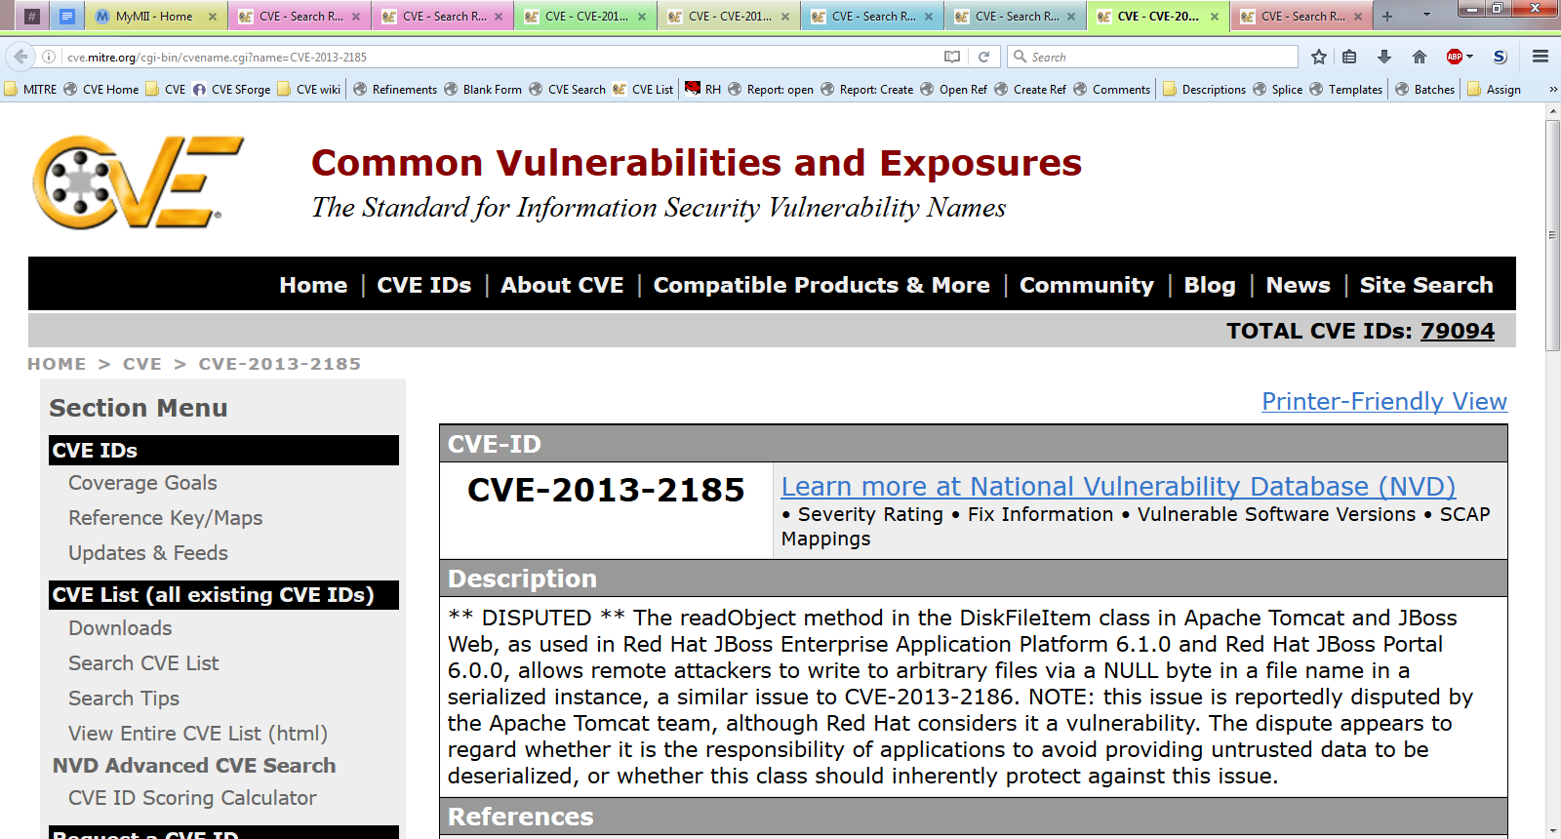
Dispute Example
Notes:
Voice Track: Here is an example of a disputed CVE entry.
Apache maintains Tomcat
Red Hat uses Tomcat in its JBoss products
Redhat thinks there is a vulnerability in Apache Tomcat
Apache thinks there is NOT a vulnerability
Redhat still needs a CVE ID for coordination, hence we mark the CVE as disputed

Slide 52
Escalation
Notes:
Voice Track: How do CVE ID’s get disputed; they get escalated to a Root CNA

Slide 53
Escalation Process
If the authorized CNA rejects the change or is unresponsive:
  The requester can escalate to the appropriate Root CNA
  The Root CNA requests the reasoning behind the Sub-CNA’s decision
  The Root CNA determines which action is appropriate
  The Root CNA informs the requester and the Sub-CNA of its decision
Notes:
Voice Track: If the authorized CNA rejects the change or is unresponsive, the requester can escalate to the appropriate Root CNA, the Root CNA requests the reasoning behind the Sub-CNA’s decision, the Root CNA determines which action is appropriate and the Root CNA informs the requester and the Sub-CNA of its decision.

Slide 54
CVE ID Expiration
Notes:
Voice Track: CVE IDs expire

Slide 55
CVE ID Expiration
CVE ID’s assigned to a vulnerability that are NOT published do not expire
Unassigned CVE IDs for a given year expire at the end of the year
Each CNA is expected to tell their parent CNA which CVE IDs they did not use
Secretariat will reject the CVE IDs that are not used
Notes:
Voice Track: CVE ID’s assigned to a vulnerability that are NOT published do not expire. However,
unassigned CVE IDs for a given year expire at the end of the year. Each CNA is expected to tell their parent CNA which CVE IDs they will not use, and the Secretariat will reject the CVE IDs that are not used.

Slide 56
CNA Records Assignments
CVE ID Assignment Records
Vuln. A | CVE-YYYY-1024 | Populated
Vuln. B | CVE-YYYY-1025 | Populated
Vuln. 2 | CVE-YYYY-1026 | Populated
Vuln. 6 | CVE-YYYY-1027 | Populated
Vuln. X | CVE-YYYY-1028 | Waiting for Publication
Vuln. Y | CVE-YYYY-1029 | Waiting for Publication
 | CVE-YYYY-1030 | Unassigned
 | CVE-YYYY-1031 | Unassigned
 | CVE-YYYY-1032 | Unassigned
 | CVE-YYYY-1033 | Unassigned
Notes:
Voice Track: In this example, this CNA had ten CVE ID’s assigned to them; four CVE IDs are populated, two CVE ID’s are awaiting publications and four are unassigned. The four unassigned CVE ID’s will expire at year end. Notify the Secretariat of any unassigned CVE IDs so the Secretariat can reject the unused CVE IDs.

Slide 57
CNA returns unused CVE IDs
CVE IDs unused in YYYY:
CVE-YYYY-1030
CVE-YYYY-1031
CVE-YYYY-1032
CVE-YYYY-1033
CNA
Secretariat
Notes:
Voice Track: At the end of the calendar year, CNAs return unused CVE IDs.

Slide 58
Secretariat Updates the Master CVE List
Before
After
Name: CVE-YYYY-10230Status: Candidate
URL: http://cve.mitre.org/cgi-bin/cvename.cgi?name=CVE-YYYY-1030
Phase: Assigned (YYYYMMDD)
Category:
** RESERVED **
This candidate has been reserved by an organization or individual that will use it when announcing a new security problem. When the candidate has been publicized, the details for this candidate will be provided.
Name: CVE-YYYY-10230Status: Candidate
URL: http://cve.mitre.org/cgi-bin/cvename.cgi?name=CVE-YYYY-1030
Phase: Assigned (YYYYMMDD)
Category:
** REJECT **
DO NOT USE THIS CANDIDATE NUMBER. Consult: none. Reason: The CNA or individual who requested this did not associated with any vulnerability during YYYY. Notes: none.
Notes:
Voice Track: Secretariat updates the master CVE List.

Slide 59
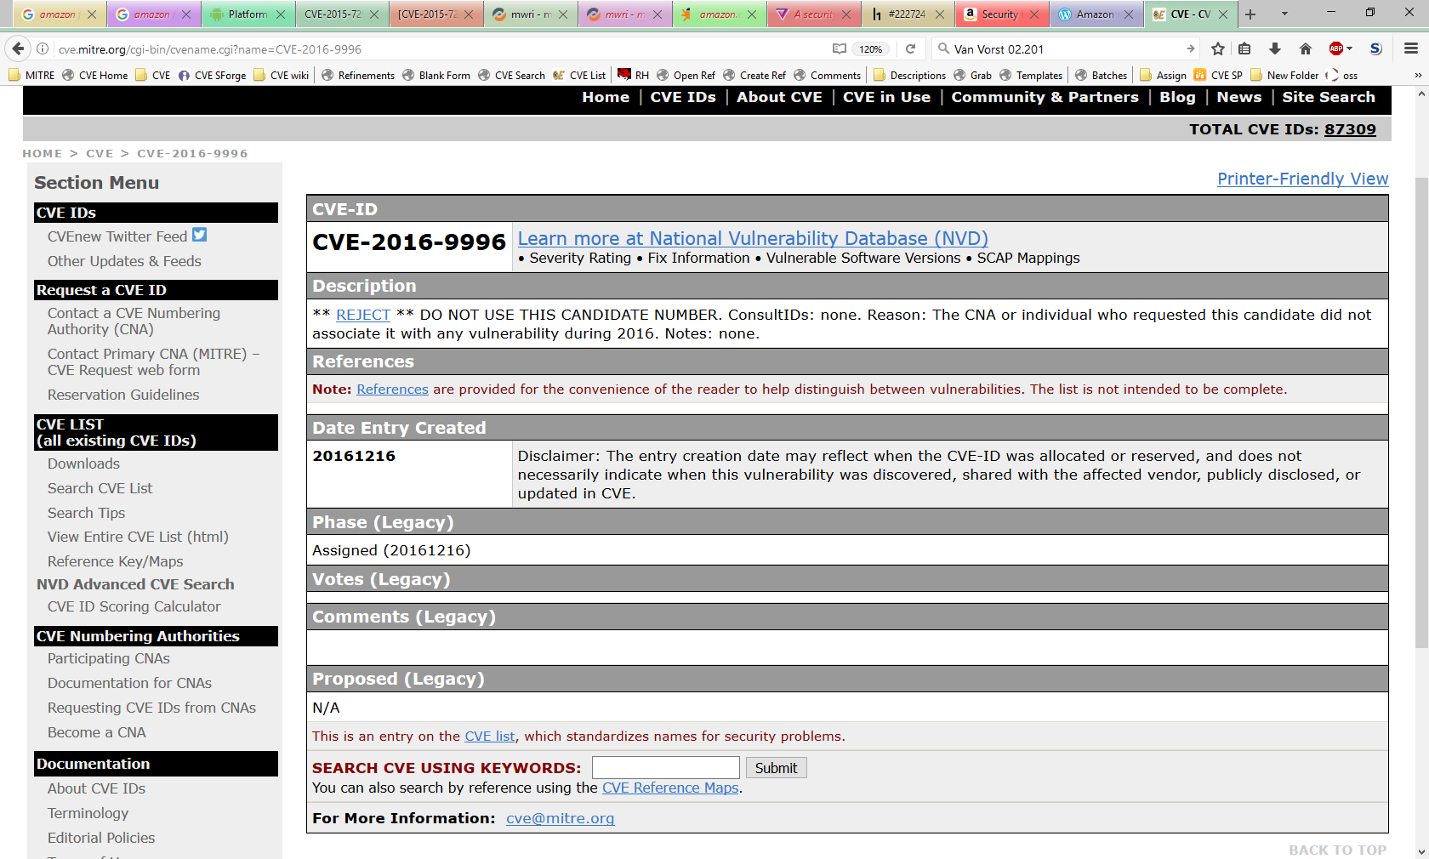
Unused CVE ID is marked Rejected
Notes:
Voice Track: Here is an example of an unused CVE ID that is marked as rejected.

Slide 60
Conclusion
| 60 |
Notes:
Voice Track: This concluded this presentation.

